Slide 1
Covid-19 impact on airport operations
mgr inż. Malwina Okulicz, mgr inż. Paulina Rutkowska
Warsaw University of Technology, Faculty of Transport
20th October 2020

Slide 2
Agenda
Introduction
Aim of the research
Physical distancing solutions
Covid-19 impact on Ground Handling
Airport operational capabilities
Measurements & Data analysis
A-CDM potential
Summary & Conclusions

Slide 3
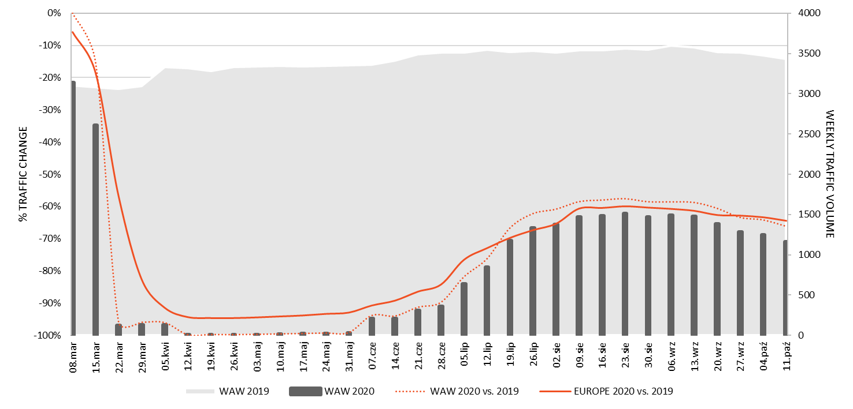
Introduction
Source: own study based on OAG Analyser
COVID-19 IMPACT ON OPERATIONS

Slide 4
Aim of the research
01
02
03
Analysis
Research
Result
Analysis of the impact of the new procedures related to the need to maintain physical distancing on airport operations.
Investigation of both operational and organizational behaviors at the airport during pandemic using A-CDM.
Indication of the Airport Collaborative Decision Making (A-CDM) potential in the new operating conditions.

Slide 5
Physical distancing solutions
Terminal
Allocating every second service desk
Physical distancing in terminal building
Airside
Disinfection of aircraft interiors and passenger shuttle buses
Controlled boarding
Limiting the number of passengers on shuttle buses
Hand luggage restrictions on board
Controlled deboarding

Slide 6
Covid-19 impact on Ground Handling
Terminal
Airside
Taking into account greater flexibility (buffer) in rotations, when planning airport operations
GH Agents
Greater flexibility and shift work
Increased effort in the area of passenger traffic organization
Extension of boarding and deboarding times
Extension of checked baggage processing times
Extension of turnaround times
Increased demand for airport resources, i.e. infrastructure, personnel and equipment (e.g. shuttle buses)

Slide 7
Airport operational capabilities
A-CDM System
TSAT
ALDT
TOBT
EXOT
ATOT

Slide 8
Airport operational capabilities
Research details
01
02
03
Research sample
Tools
Methods
The research sample is 200 turnarounds collected from 1st July to mid-August (excluding Saturdays and Sundays).
A-CDM Platform: pilot.polish-airports.com/ Flight Radar 24:
flightradar24.com/
and Field measurements
Desk research.
Statistical analysis.
Comparative analysis.
Variables
ALDT – Actual Landing Time
ATOT – Actual Take-off Time
CTOT – Calculated Take-off Time
TOBT – Target Off-block Time
TSAT – Target Start-up Approval Time

Slide 9
Measurements & Data analysis
Operational results
01
02
03
Pre-covid
Traffic suspension
Traffic recovery
Continuous traffic growth.
A-CDM Platform implemented but still being in testing phase.
Unpredicted flight cancelations.
Approx. 93% decrease of ATMs.
Only cargo and repatriation flights.
Significant flights decrease.
Loss of passenger confidence to air traveling.
Traffic profile change (short-haul flights domination).
VALUE | TURNAROUND TIME IN 2019 | TURNAROUND TIME IN 2020
AVERAGE | 01:48:52 | 03:22:56
MINIMUM | 00:30:00 | 00:42:00
MAXIMUM | 13:10:00 | 16:14:00
AVERAGE (WIDE-BODY AIRCRAFT) | 01:48:52 | 10:33:12
AVERAGE (NARROW-BODY AIRCRAFT) | 00:30:00 | 03:00:17

Slide 10
Measurements & Data analysis
Organizational results
01
02
03
Pre-covid
Traffic suspension
Traffic recovery
A-CDM Platform implemented but still being in testing phase.
No detailed measures.
Abandoned data updates in A-CDM Platform.
Aircraft when ready than start-up and take-off (up to an hour before TOBT).
Not always available updates of data or certain data input.
TOBT and TSAT compliance: 96%
TOBT accuracy:
54%
TOBT adherence:
min. 70%

Slide 11
A-CDM potential
Main principle
The A-CDM system fulfills its role as long as the A-CDM platform is supplied with reliable operational data, at the right time and with sufficiently precise accuracy.

Slide 12
A-CDM potential
Operational role
The A-CDM system functions that support the operational work during Covid-19
Integration of all operational data
Increasing the automation of the information exchange
Maintaining an appropriate level of availability and quality of the information provided

Slide 13
A-CDM potential
Organizational role
The potential A-CDM features that could support the operational work during Covid-19
Enriching the A-CDM platform with key data on the epidemiological situation
Extending the system database with a list of new operation procedures
Addition the information on temporary exclusion of airspace or airport zones
Possibility to provide detailed information about possible Sars-Cov-2 virus infection on a given flight

Slide 14
A-CDM potential
Key indicators
Static indicators
List of countries banned from international flights
Airspace zones excluded from use for transit traffic
Dynamic indicators
Alert about the threat of Sars-Cov-2 infection on a given flight
List of new or updated airport procedures
Aircraft occupancy – with a list of crew members, passengers and personnel quarantined
Airport zones and resources allocated to handle a flight at risk of contamination
Information on temporary separation or closure of airport zones from use

Slide 15
Summary & Conclusions
Restoring domestic and international flights requires even closer cooperation between countries based on the synchronization of actions taken
The conducted research clearly shows that the pandemic to some extent had an impact on the ground handling of aircraft, extending almost twice the average values ​​of turnaround times compared to the same period in 2019
Variable and uncoordinated constraints during Covid-19 pandemic affect airport operations, generating chaos in the airline industry and a decline in passenger confidence in air travel

Slide 16
Summary & Conclusions
The main advantage of A-CDM is the ability to dynamically manage airport operations and the resources necessary to handle them using airport database updated by users on an ongoing basis
We recommend implementing Covid-19 module in the A-CDM system that has potential to reduce the negative impact of the pandemic on airport operations
Improving cooperation and situational awareness at the airport can be solved by using existing support systems (i.e. A-CDM)

Slide 17
Covid-19 impact on airport operations
mgr inż. Malwina Okulicz, mgr inż. Paulina Rutkowska
Warsaw University of Technology, Faculty of Transport
Bibliography
ACI (2020): Aviation Operations During COVID-19 Business Restart and Recovery. Issue 01
Art. 176 of the Aviation Act of 3 July 2002 (Journal of Laws of 2019, item 1580)
Chopin Airport (2020): News and events, www.lotnisko-chopina.pl/
EASA (2020): Guidance on aircraft cleaning and disinfection in relation to the COVID-19 pandemic. Issue 02
EASA, ECDC (2020): COVID-19 Aviation Health Safety Protocol Guidance for the management of airline passengers in relation to the COVID-19 pandemic. Issue 01
EUROCONTROL (2017): Airport CDM Implementation - The Manual, Version 5.0
EUROCONTROL (2020): Impact assessment of covid-19 measures on airport performance. Ed. 1.0
Habida, E., Ebrahim, S. H., Gozzer E. (2020): COVID-19: Facemask use prevalence in international airports in Asia, Europe and the Americas, March 2020. Travel Medicine and Infectious Disease, vol. 35, 101637.
Harris, M., Adhanom Ghebreyesus, T., Liu, T., Ryan, M. J., Vadia, Van Kerkhove, M. D., Diego, Foulkes, I., Ondelam, C., Gretler, C. and Costas (2020): COVID-19. World Health Organization
Hirok Nakamura, H., Managi, S. (2020): Airport risk of importation and exportation of the COVID-19 pandemic. Transport Policy, vol. 96, p. 40-47
ICAO (2020): COVID-19 Safety Operational Measures, www.icao.int/safety/COVID-19OPS/, [access: 2020-08-24]
Iacus, S. M., Natale, F., Santamaria, C., Spyratos, S., Vespe, M. (2020): Estimating and projecting air passenger traffic during the COVID-19 coronavirus outbreak and its socio-economic impact. Safety Science, Volume 129, September 2020, 104791
IATA (2020): Aircraft cleaning and disinfection during and post pandemic, Ed. 1
IATA (2020): Guidance for ground handling during COVID-19, IATA, Ed. 5

Slide 18
Covid-19 impact on airport operations
mgr inż. Malwina Okulicz, mgr inż. Paulina Rutkowska
Warsaw University of Technology, Faculty of Transport
Bibliography
IATA (2020): Guidance for ground handling return to service, IATA, Ed.1
ICAO (2020): Effects of Novel Coronavirus (COVID-19) on Civil Aviation: Economic Impact Analysis. Montréal, Canada
ICAO (2020): CART Report: Flightplan for Restart and Recovery
ICAO, Council Aviation Recovery Task Force (2020): Take-off: Guidance for Air Travel Through the COVID-19 Public Health Crisis
ICAO (2020): Covid-19 outbreak simplified procedure for air traffic management collaborative decision making and sharing of information. Ed. 1.0
Kierzkowski, A., Kisiel, T. (2020): Simulation model of security control lane operation in the state of the COVID-19 epidemic. Journal of Air Transport Management, vol. 88, 101868
Kinlaw, K., Levine, R. J. (2007). Ethical guidelines in Pandemic Influenza - Recommendations of the Ethics Subcommittee of the Advisory Committee to the Director, Centers for Disease Control and Prevention. Centers for Disease Control and Prevention
Polish Civil Aviation Authority (2020): Number of passengers and operations performed in domestic and international traffic - regular and charter in the first quarter of 2018 – 2020 [on-line]. ulc.gov.pl, [access 2020-08-26]
Regulation of the Council of Ministers of March 13, 2020 on air traffic bans (Journal of Laws of 2020, item 436)
Regulation of the Council of Ministers of June 16, 2020 on air traffic bans (Journal of Laws 2020, item 1050)
Regulation of the Council of Ministers of 30 June 2020 on air traffic bans (Journal of Laws 2020, item 1160)
Regulation of the Minister of Transport, Construction and Maritime Economy of 19 November 2013 on ground handling at airports (Journal of Laws 2018.1287)
Serrano, F., Kazda, A. (2020): The future of airports post COVID-19 Journal of Air Transport Management. Volume 89, October 2020, 101900
Żmigrodzka, M., Krakowiak, E. (2018): Technical security systems in airport security. WUT Journal of Transportation Engineering, Issue 122 (in polish)

