Slide 1
Civil Aviation Flight Safety:
Pilot Properties Soft Computing
Nikolai I. Plotnikov
Scientific Research Project Civil Aviation Institute «AviaManager»
630078 Novosibirsk, Russian Federation
am@aviam.org
October 20, 2020

Slide 2
Agenda
Introduction
Problem
Theory
Soft Computing Method
Experiment: Statistical Analysis and Expert Evaluation
Results

Slide 3
Introduction
When you called a taxi,
you looked out the window and appreciated the weather,
but you do not know the state of the car… and especially ...
state and qualifications of a driver to whom do you hand your life…
Just the same - when you go on a flight by plane
Nevertheless you go with expectation on service provider BRAND
Human being properties as knowledge, experience, qualification, state of fatigue are blurry to estimate…
This paper about workload magnitude

Slide 4
Problem
Annual unpredictable aviation accidents (AA)
The commercial pressure of competition
Unknown dependability of flight crews based on workload and experience
Unknown methods of calculating the properties of a person and social groups
International standards constitute problematic content in safety terminology
Statistical data and expertise may be piecewise defined, inaccurate and inconsistent
The lack of theory and methods for calculating the properties of objects for the safe regulation

Slide 5
Method
It is used the method of soft computing (SC), statistical and expert methods for calculating the properties of a person (pilot) and social groups (flight crew) in the management of dangerous professions.
It is used logical statements, heatmaps, and experiments.

Slide 6
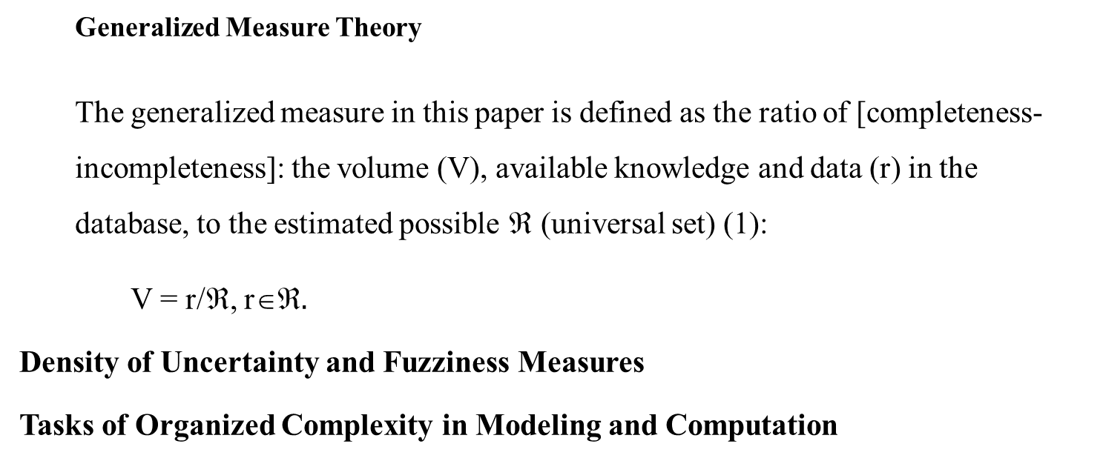
Theory
  Generalized Measure Theory
  The generalized measure in this paper is defined as the ratio of [completeness-incompleteness]: the volume (V), available knowledge and data (r) in the database, to the estimated possible ℜ (universal set) (1):
V = r/ℜ, r$.$
Density of Uncertainty and Fuzziness Measures
Tasks of Organized Complexity in Modeling and Computation

Slide 7
Soft Computing Method
  Formal Soft Computing Definition Output
  Soft computing is a set of methods: hard estimation (HE), soft measurement (SM), soft estimation (SE) in metric and non-metric scales with the ability to simultaneously process quantitative numerical and qualitative linguistic data.
  µ_SM, µ_HE, µ_SE

Slide 8
Task statement: management decisions example
Pilot experience, flight ours values | Risk levels probability P: AA per million flight per year | SC options | Management decisions example
1 | 2 | 3 | 4
{1} big | P = AA 10⁻⁷ (green) | (µ_HE] | free, strong
{2} middle | P = AA 10⁻⁶ (yellow) | (µ_SE) | free, free
{3} small | P = AA 10⁻⁵ (red) | [µ_SM] | strong, strong

Slide 9
Experiment: Statistical Analysis and Expert Evaluation
Used known studies of the dependence of human errors on the properties of the individual, statistical data, large analyzes
The analyses are based on large statistical studies covered a period of up to a maximum of 10 years of more than 3,000 people (pilots)
Statistical analysis of AA consists in establishing the relationship between the experience of pilots by flight hours
The method of expert assessments includes: preliminary selection of experts, organized assessment procedures, development of a matrix of SC values, data processing, analysis and output of indicator values.

Slide 10
Results about workload
The values of the pilot's operational dependability indicators are set:
[minimum (nominal) maximum]:
flight hours: monthly [20 (50] 80], annually [150 (400] 800];
number of flights: monthly [5 (10] 20], annually [30 (75] 200].

Slide 11
Normative empirical portrait of absolute professional pilot dependability green flight safety level
Professional pilot, captain, aged 35-55 years, with more than 10 years of flight experience, with a total flight time of more than 10,000 hours on aircraft of I-III classes in aviation work and short, medium and long-distance routes, with experience of more than 5000 take-offs and landings, day and night, in simple and complex weather conditions of all seasons of the VFR and IFR, in various geographic flight conditions.
Thank you
Nikolai I. Plotnikov, Ph.D. (Tech), Engineer-pilot

