Slide 1
Methods of Resource Modeling of Organizational Objects
Nikolai I. Plotnikov
Scientific Research Project Civil Aviation Institute «AviaManager»
630078 Novosibirsk, Russian Federation
am@aviam.org
October 20, 2020

Slide 2
Agenda
Introduction
Foundations of the Resource Theory and Method
Ontology of Resource Modeling
Resource Definition
Formal Resource Model (FRM)
Resource Practical Design Example

Slide 4
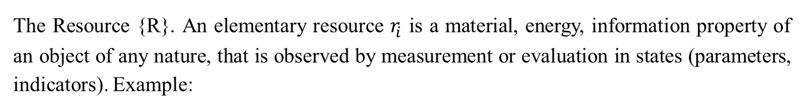
Definition
The Resource {R}. An elementary resource $r_{i}$ is a material, energy, information property of an object of any nature, that is observed by measurement or evaluation in states (parameters, indicators). Example:
Objects | Human (pilot) | Machine (aircraft) | Environment (airport)
Property | Parameters and indicators
material | height | mass | runway length
energy | age | speed | passenger capacity
information | flight hours | range | number of shipments per year

Slide 5
Formal Resource Model (FRM)

Slide 6
Resource complex

Slide 7
Resource tuple

Slide 8
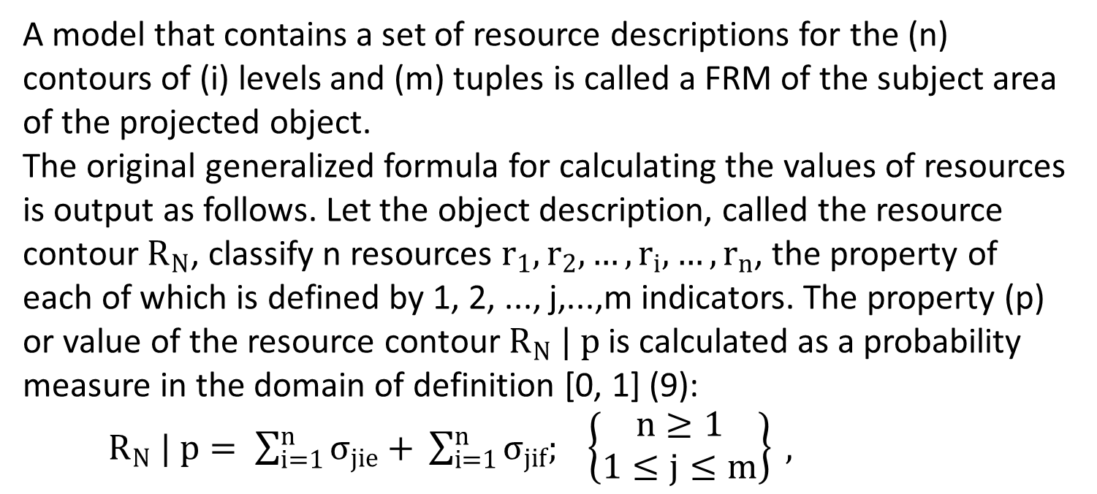
Resource complex generalized formula
A model that contains a set of resource descriptions for the (n) contours of (i) levels and (m) tuples is called a FRM of the subject area of the projected object.
The original generalized formula for calculating the values of resources is output as follows. Let the object description, called the resource contour $R_{N}$, classify n resources $r_{1},r_{2}, …,r_{i},…, r_{n}$, the property of each of which is defined by 1, 2, ..., j,...,m indicators. The property (p) or value of the resource contour $R_{N} | p$ is calculated as a probability measure in the domain of definition [0, 1] (9):
$R_{N} | p= \sum_{i=1}^{n}{σ_{jie}+} \sum_{i=1}^{n}{σ_{jif}; \left\{\begin{aligned}n≥1 \\ 1≤j≤m\end{aligned}\right\} },$

Slide 9
Resource Practical Design Example

Slide 10
Results
Resourcology: theory and method is proposed by the author as a new independent approach of ontological design of reality
An original resource method has been developed, which has technical-economic and natural-scientific bases, universal theoretical and applied character in modeling and management of organizational social and economic objects.
Thank you
Nikolai I. Plotnikov, Ph.D. (Tech), Engineer-pilot

