Slide 1
Reliability of UAV in fire services operations. Tests and measurements of selected parameters
Radosław Fellner, Maciej Zawistowski, Piotr Sadowski
Scientific and Research Centre for Fire Protection – National Research Institute (CNBOP-PIB)
20.10.2020 r.

Slide 2
Agenda
Introduction
Example usage of UAVs in fire protection
Key parameters for the operation of the UAV
Research results
Conclusions

Slide 3
Introduction
For a flying platform to be able to successfully fulfill the operation goals and various services formations necessary tasks, it must be characterized by a high safety and reliability factors, and meet specific parameters necessary to perform the mission,
Currently, the parameters provided by manufacturers are often determined at dis-cretion and are not verified by any institution confirming its technical parameters such as hovering time or weather resistance, such as e.g. IP.,
In the following article, the authors aim was to determine the most important parameters affecting the possibility UAV usage in the realities of the fire service operations.

Slide 4
Example usage of UAVs in fire protection
Who & where UAVs are used
State Fire Service,
Voluntary Fire Brigades,
fire of styrofoam factory in Manasterz,
Fire in Biebrza National Park,
garbage dump fires,
Notre Dame Cathedral (France),
How UAVs are used
RGB and themral imaging,
monitoring of rescue and firefighting activity
explore areas, search missions,
measuring of air polution,
broadcast messages,

Slide 5
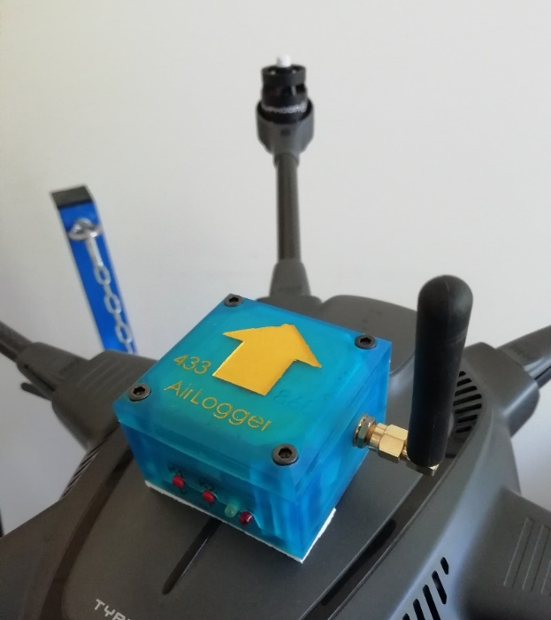
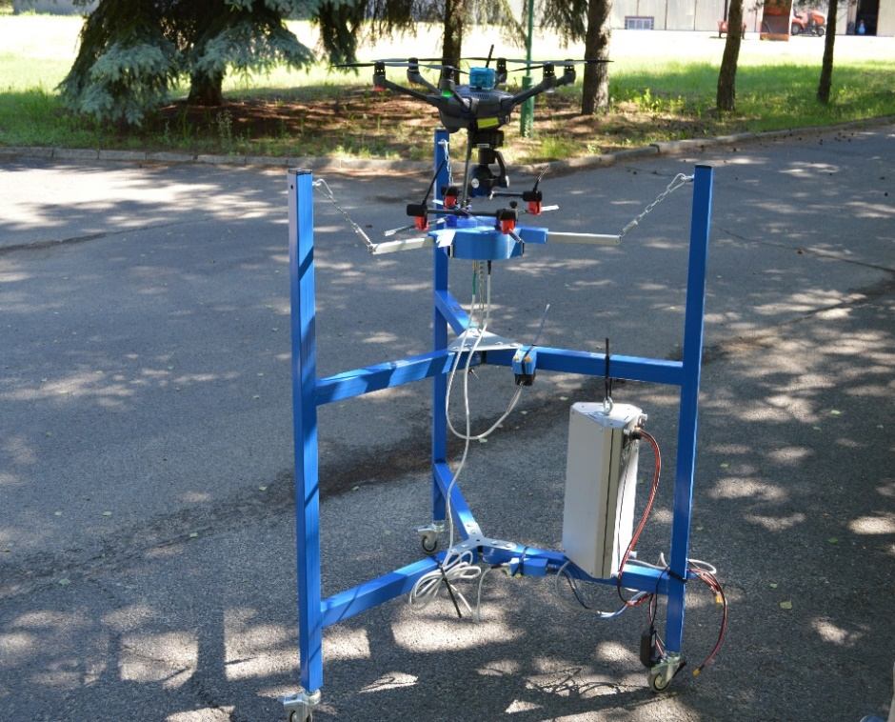
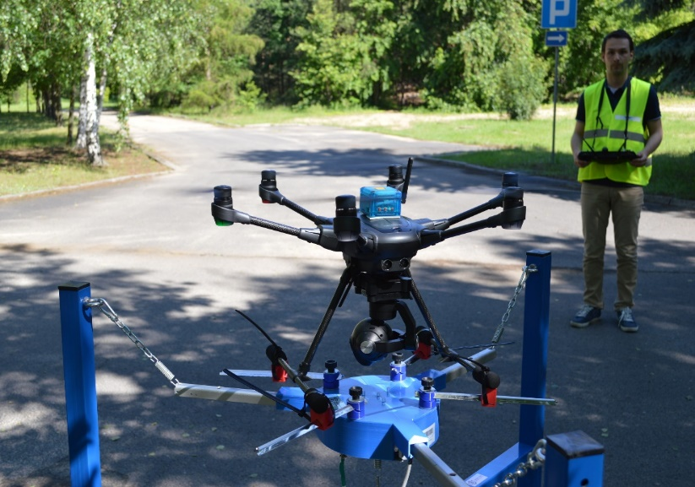
Key parameters for the operation of the UAV
Power consumption,
Figure of Merit,
Mass,
Thrust,
Battery capacity,
Center of Gravity location,
Hoover accuracy ,
Flight time,
Horizontal maximum velocity,
Telemetry position accuracy,
FFT frequency,
Vertical rate of climb, vertical rate of descent

Slide 6
Key parameters for the operation of the UAV
Lp. | Parameter | Impact on UAV performance and functions
1 | Power consumption | Power consumption allows to determine: - determining the maximum current drawn from the battery and check the selection of individual components (power supplies), - determination of flight time in given conditions (e.g. temperature), - differences in absorbed power (recorded during service inspections) may indicate a poor technical condition of UAV.
2 | Mass | It allows UAV to qualify to the appropriate weight category according to aviation law (up to 5 kg, up to 25 kg, 150 kg)
3 | Center of Gravity location | The center of gravity shift causes: - reduction of the maximum load weight and uneven exploitation of the propulsion system parts, which may increase the likelihood of failure, - results in poorer controllability (limiting movements in the opposite direction to the center of gravity shift), -un-maneuverability
4 | Horizontal maximum velocity | Faster reaching the place of the incident.
5 | Meteo conditions (air temperature, humidity, pressure) | By measuring and recording atmospheric conditions, it can be determined whether a given UAV (for which conditions of use have been specified) can be used for operations. The lower the temperature, the faster the battery will discharge, and therefore the shorter flight time

Slide 7
Research results
As part of the statutory work, various UAV ( custom, Spartaqs, Yuneec, DJI, Parrot) were tested using the DronesBench device. The research allowed to check and confirm the parameters declared by the producers. Such an operation should be performed periodically, allowing the equipment to be kept in the best technical condition, and in the case of various services - combat-ready. The research focused on electrical and mechanical parameters of various platforms. The tests allowed for checking e.g.:
location of the centers of gravity of the above platforms,
weights with the battery and accessories,
average and peak values of the current drawn from the battery.
The test results confirmed mainly the flight time assumed by the manufacturers and a good (centric) location of the center of gravity ensuring even load on the multirotor engines.

Slide 8
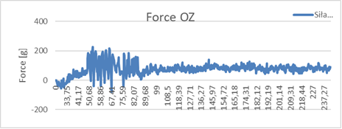
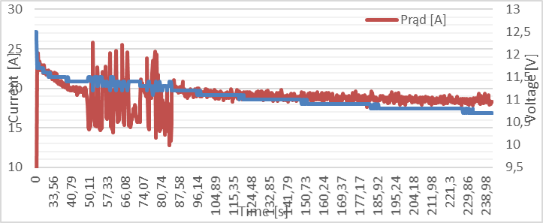
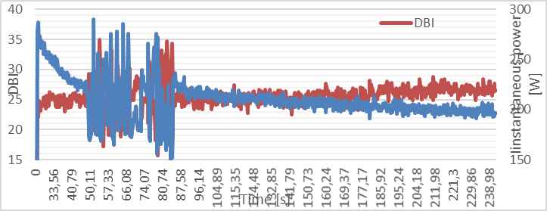
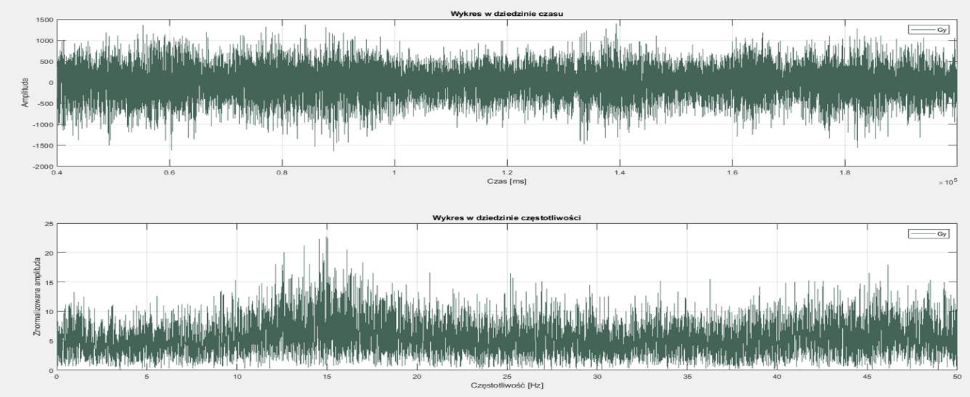
Research results

Slide 9
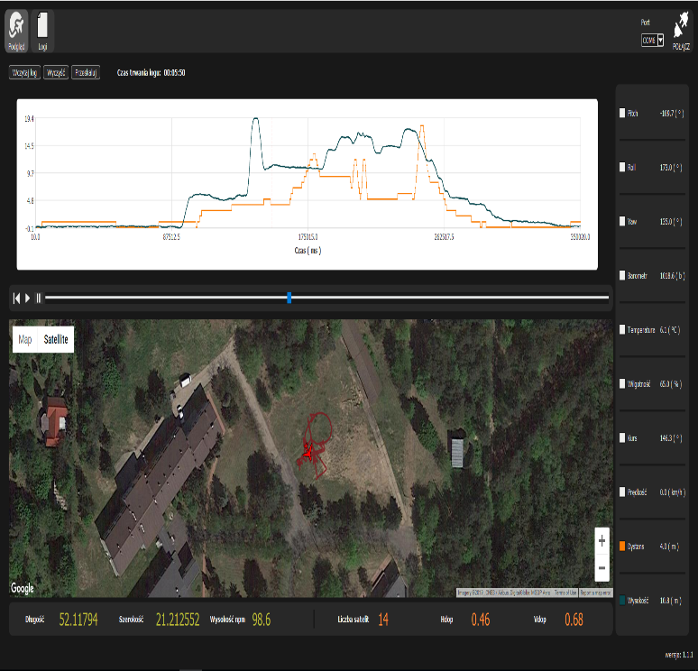
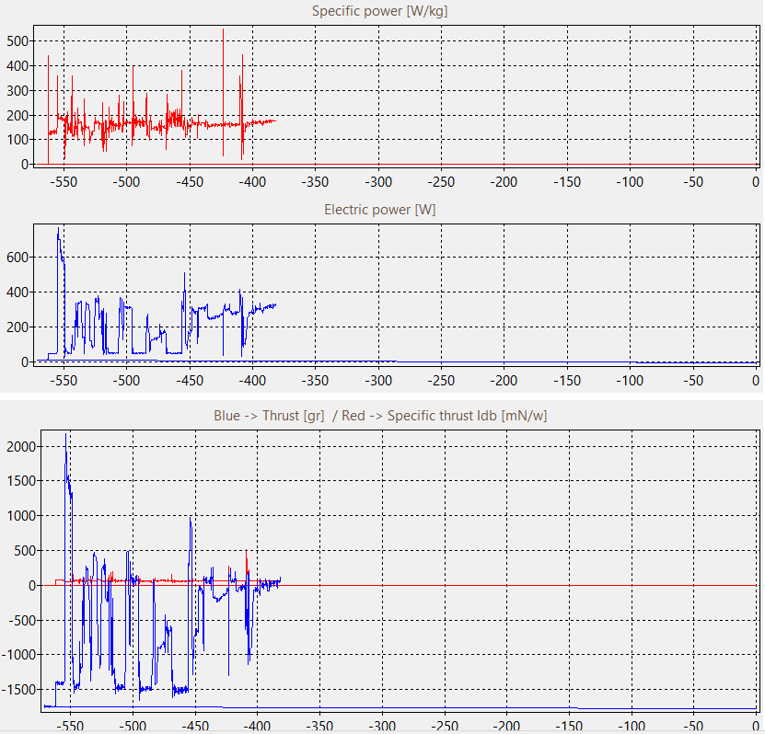
Research results
Main view from AirLogger application with registered values
Graphics with values recorded by the DronesBench device

Slide 10
Conclusions
results of this work may allow for the initial systematization of formal, legal, research and operational aspects regarding the use of UAVs during rescue and fire-fighting activities. Up to now, there have been no such analyzes performer,
during the implementation of the test, it was noted that there was still a lack of adequate methods of UAV verification used by authority services in suboptimal con-ditions (operation or mission conditions).
There is the legitimacy of deepening the subject of research methodologies and UAV exposures used by the services. Quality management systems and tests determined from the perspective of the end user's needs of fire brigades is a challenge that the project team wants to face in the near future

Slide 11
Reliability of UAV in fire services operations. Tests and measurements of selected parameters
Radosław Fellner, Maciej Zawistowski, Piotr Sadowski
Scientific and Research Centre for Fire Protection – National Research Institute (CNBOP-PIB)
Bibliography
Feltynowski M., Zawistowski M.: Threats related to the use of unmanned systems in emergency services. Safety & Fire Technique 51/3 (2018).
Feltynowski M., Zawistowski M.: Opportunities related to the use of unmanned sys-tems in emergency services. Safety & Fire Technique 51/3 (2018).
A fire in a carpentry workshop in Podkarpacie. "There was no way to put it out", https://www.polsatnews.pl/wiadomosc/2019-12-16/pozar-w-zakladzie-stolarskim-na-podkarpaciu-nie-bylo-szans-tego-ugasic/, last accessed 2020/05/17
Petritoli, E., Leccese, F., Ciani, L.: Reliability and maintenance analysis of unmanned aerial vehicles. Sensors 18(9), 3171 (20318)
Valavanis, K. P., Vachtsevanos, G. J. (Eds.): Handbook of unmanned aerial vehicles, Springer Netherlands (2015)

