Slide 1
Competitiveness Assessment of Polish Regional Airports Based on Location Planning Models
Jakub Dyrcz, Allan Nõmmik, Wioletta Binkowska, Dago Antov
Politechnika Krakowska
Tallinn University of Technology
Estonian Aviation Academy
Jagiellonian University
20.10.2020

Slide 2
Agenda
Introduction
Airports in Poland
Location planning models
Results of the Polish case study
Discussion and Conclusions

Slide 3
Introduction
Regional Airport Theory:
Regional airport is a non capital airport for servicing small geographical areas.
Regional airports for regional aircrafts or aircrafts, which are used by regional (feeder) airlines.
Regional airport could be understood as a non-hub airport, without transfer traffic.
Due the impact of market liberalization numerous small airports are losing or have already lost their traffic.
The European Commission starts to focus on the regulation of public investments to European airports to ensure more private investments for renovation and development of the airports.

Slide 4
Introduction
US FAA approach for categorization of airports in the European environment
Annual amount of enplaned passengers | Common Name | European airports
Large: 1% or more | Large Hub Primary | More than 11.06 mln
Medium: at least 0.25%, but less than 1% | Medium Hub Primary | At least 2.77 mln, but less than 1.06 mln
Small: at least 0.05%, but less than 0.25% | Small Hub Primary | At least 0.55 mln, but less than 2.77 mln
Non-hub: more than 10000, but less than 0.05% | Non-hub Primary | More than 16000, but less than 0.55 mln
Non-hub: more than 2500, but less than 10000 | Non-primary | More than 4000, but less than 16000
Source: US Federal Aviation Administration. Airport Categories.
Investment rates according to airport size
Financial viability of airports depending on passenger traffic
Annual passenger traffic | Description
Up to 200000 | May not be able to cover their operating costs to a large extent
Between 200000 and 700000 | May no be able to cover their operating costs to a substantial extent
Between 700000 to 1 million | Should in general be able to cover their operating costs to a greater extent
Between 1 to 3 million | Should, on average, be able to cover the majority of their operating costs.
Above 3 million | Usually profitable at operating level and should be able to cover their operating costs.
Size of airport | Maximum investment aid intensity
>3-5 million | up to 25 %
1-3 million | up to 50 %
<1 million | up to 75 %
Source: Guidelines on State aid to airports and airlines, 2014.

Slide 5
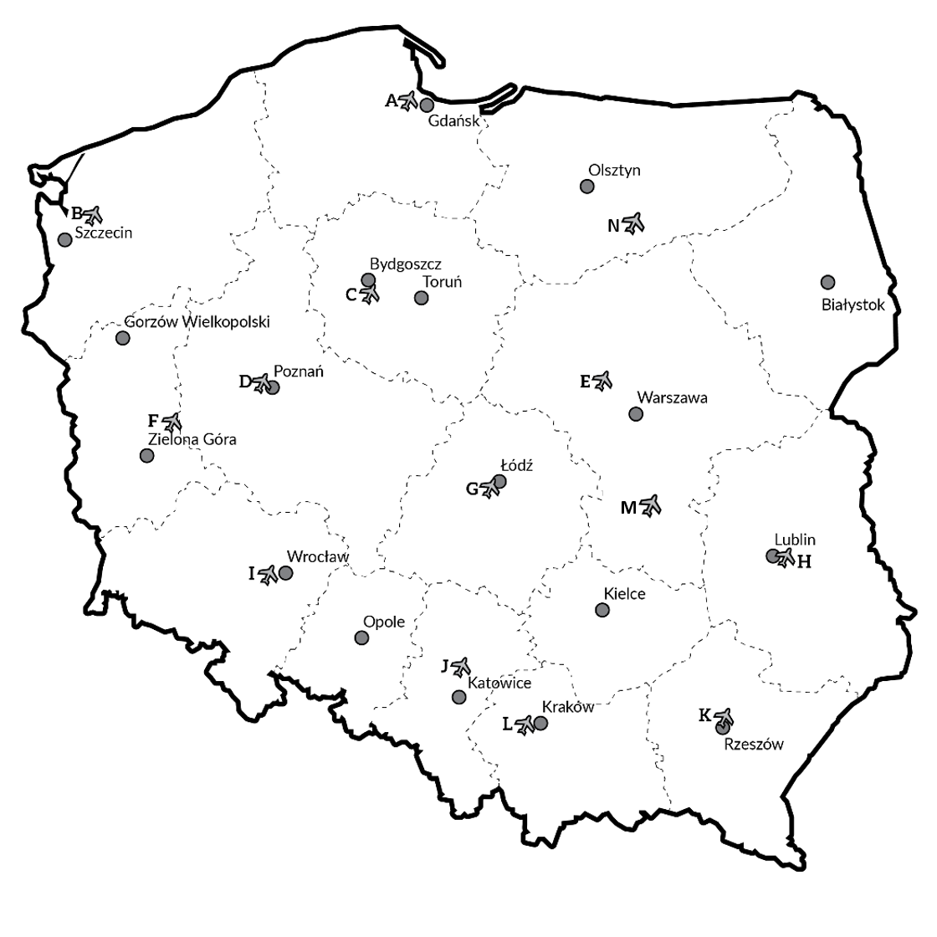
Airports in Poland
By the end of July 2019, the network airports in Poland includes 64 civil airports (ULC, Rejestr lotnisk i ewidencja lądowisk, 2019):
14 certificated public-use airports,
9 public-use airports with limited certification,
21 public-use airports, which are not liable to be certificated,
20 airports for exclusive use.
Warsaw Chopin Airport was not taken into consideration:
the main airport in the country, at the moment.
the main interchange hub for national "flag carrier" - Polskie Linie Lotnicze LOT S.A.
Warsaw Radom Airport was taken into account for the analysis:
in the years 2016 and 2017 it functioned normally operating domestic and international flights.
his airport has enough developed infrastructures.

Slide 6
Location planning models to assess the competitiveness of regional airports
Modelling background:
Classical field of implementation – logistics,
Amount of clients (demand points),
Amount of potential warehouses (facilities).
P-Center Model:
Its goal function minimizes the maximum distance to each client from its closest facility.
P-Median Model:
It finds the best locations of facilities to minimize the demand-weighted total distance between demand points and the facilities, to which they are assigned.
The objective is to assess how airports transferred their competitive potential provided by their location in winning the passengers by comparing ranking based on the calculation of models with ranking based on passenger traffic.

Slide 7
Location planning models to assess the competitiveness of regional airports
Adaptation of models:
Clients – Polish voivodeships;
Facilities – selected Polish airports;
Population of voivodeships as weights for models;
Distance matrix from Google Maps based on origin-destination Matrix, where origins – capitals of voivodeships, destination – selected airports.
Two additional important assumptions in case of population:
Warszawa will be considered regardless the fact that the Warsaw Chopin Airport is situated inside the city:
there are 2 other airports (Warsaw Modlin Airport and Warsaw Radom Airport), which are partly or fully orientated on Masovian Voivodeship.
Kuyavian-Pomeranian Voivodeship as well as Lubusz Voivodeship have two capitals, which means two gravitation points per administrative unit:
their populations were divided proportionately with inhabitants of their capitals.

Slide 8
Results of the Polish case study
Airports | Basic ranking | Passenger volume | p-center |  | p-median |  | aggregate calculation
 |  |  | points | ranking | points | ranking | points | ranking
KRK | 1 | 5 854 516 | 66 | 1 | 45 | 1 | 111 | 1
GDN | 2 | 4 518 447 | 11 | 9 | 28 | 5 | 39 | 5
KTW | 3 | 3 968 245 | 16 | 6 | 3 | 12 | 19 | 8
WMI | 4 | 2 957 131 | 44 | 2 | 33 | 4 | 77 | 2
WRO | 5 | 2 823 819 | 12 | 8 | 20 | 6 | 32 | 6
POZ | 6 | 1 999 093 | 18 | 4 | 37 | 3 | 55 | 4
RZE | 7 | 707 736 | 5 | 11 | 5 | 10 | 10 | 12
SZZ | 8 | 548 207 | 2 | 12 | 13 | 7 | 15 | 10
LUZ | 9 | 420 007 | 3 | 13 | 9 | 9 | 12 | 11
BZG | 10 | 346 200 | 17 | 5 | 12 | 8 | 29 | 7
LCJ | 11 | 222 020 | 35 | 3 | 39 | 2 | 74 | 3
SZY | 12 | 86 566 | 1 | 14 | 4 | 11 | 5 | 14
IEG | 13 | 15 714 | 8 | 10 | 2 | 13/14 | 10 | 13
RDO | 14 | 6 289 | 14 | 7 | 2 | 13/14 | 16 | 9

Slide 9
Discussion and Conclusions
Modelling showed quite consistent results that majority of regional airports uses potential of their locations.
It was done an attempt to explain most of unclear situations, where inconsistencies between rankings were the biggest one:
Katowice Airport and Rzeszów–Jasionka Airport,
Łódź Władysław Reymont Airport and Warsaw Radom Airport.
Further aspects to consider, besides population:
number of available connections in a regional airport;
economic conditions (for example, GDP as weight);
impact of airports from the neighborhood countries;
plans of Polish government to build the Solidarity Transport Hub (Centralny Port Komunikacyjny).

Slide 10
Competitiveness Assessment of Polish Regional Airports Based on Location Planning Models
Jakub Dyrcz, Allan Nõmmik, Wioletta Binkowska, Dago Antov
Politechnika Krakowska
Tallinn University of Technology
Estonian Aviation Academy
Jagiellonian University
Bibliography
Pashkevich, A., Nõmmik, A., Antov, D. 2017. Competitiveness Analysis of Regional Airports Based on Location Planning Models: the Case Study of Finland. Proceedings of 21st International Scientific Conference. Transport Means 2017. Part III. 754-761.
Hakimi, S. 1964. Optimum location of switching centers and the absolute centers and medians of a graph. Operations Research 12, 450-459.
Saatcioglu, O. 1982. Mathematical programming models for airport site selection. Transportation Research Part B 16(6), 435-447.
Pavlyuk, D. 2014. Spatial Aspects of European Airports’ Partial Factor Productivity. Transport and Telecommunication 15, 20-26.

